Slide 1
Session 2
Web Services Description Language (WSDL)

Slide 2
Session Objectives
Justify the need for a service description language
Describe WSDL
Discuss a simple web service and its WSDL file
Describe WSDL terminologies
Analyze a WSDL file
Explain the role of SOAP in WSDL

Slide 3
Service Description Language
Platform A
Service 1
Description of service written in SDL
………….
………….
………….
Specifies functionalities of service
Platform B
Lists the parameters required by exposed method
Service 2
Lists parameters returned by methods
………….
………….
………….
Is used to document the web service contract

Slide 4
Web Service Description Language (WSDL) (1)
Web Service
XML file describing Web services acts as a contract between the web service consumer and the web service
………
………
………
Web
Service
Consumer

Slide 5
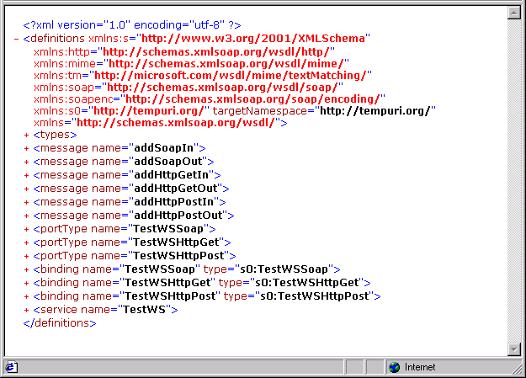
Web Service Description Language (WSDL) (2)
Specifies how the web
service can be accessed
Defines types used and
documents exchanged
Definitions associated
with network protocol
and grouped into
messages
WSDL document - a set
of definitions
WSDL Document

Slide 6
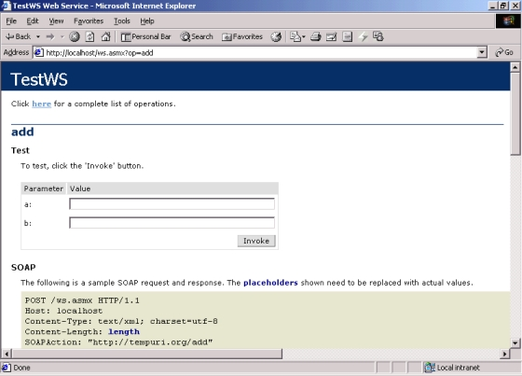
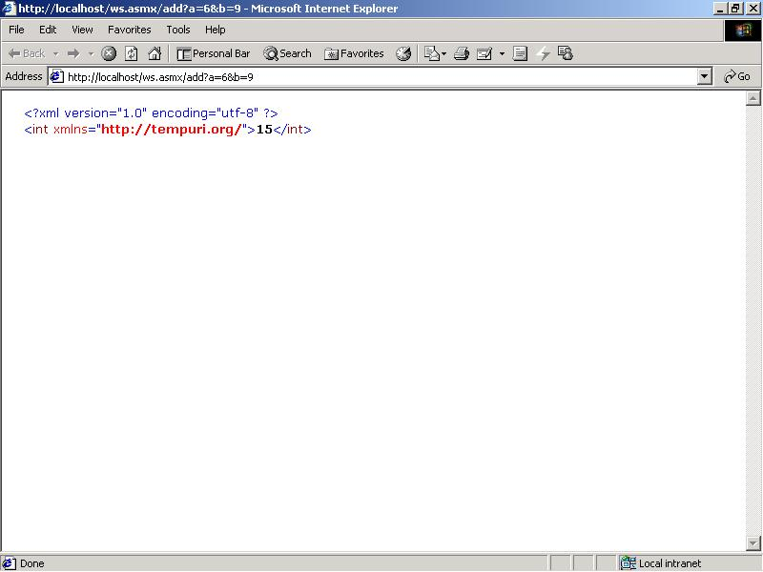
Web Service Interface
6
9
Output in XML format can be consumed by other web services

Slide 7
The WSDL File
Namespaces
<?xml version="1.0" encoding="utf-8" ?>
- <definitions xmlns:s="http://www.w3.org/2001/XMLSchema“
..... xmlns="http://schemas.xmlsoap.org/wsdl/">
+ <types>
+ <message name="addSoapIn">
.........................
+ <message name="addHttpPostOut">
+ <portType name="TestWSSoap">
..........................
+ <portType name="TestWSHttpPost">
+ <binding name="TestWSSoap" type="s0:TestWSSoap">
.........................
+ <binding name="TestWSHttpPost “type="s0:TestWSHttpPost">
+ <service name="TestWS">
</definitions>
elements

Slide 8

WSDL Terminologies (1)
SOAP Operation
SOAP Request
Ports
Web
Service
SOAP Response
CLIENT
HTTP Request
Ports
HTTP Response
HTTP Operation

Slide 9
WSDL Terminologies (2)
message: Abstract definition of the data being communicated
types: Mechanism to define data type used in web service
operation: Abstract definition of a particular action supported by the web service
port: An end-point described by the combination of a network address and binding
portType: Collection of operations
binding: Specification that lists the communication protocol and data format for a particular port type
service: Collection of ports is defined as a service

Slide 10
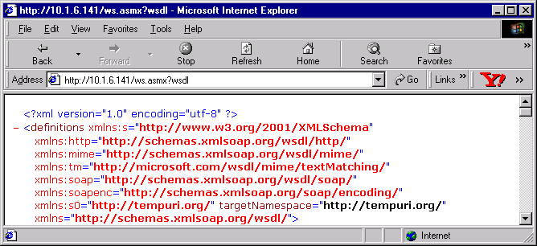
The Analysis of a WSDL File
‘definitions’ element is the root component of the WSDL file

Slide 11
Elements of a WSDL File
Abstract Definitions
Concrete Definitions
Platform and Language Independent
Machine or Language Specific
types
messages
portTypes
bindings
services
modifies
ports
operations

Slide 12
types
Describes data types used to exchange messages
- <types>
- <s:schema attributeFormDefault=“qualified”
elementFormDefault=“qualified”
targetNamespace=http://tempuri.org/>
- <s:element name=“add”>
- <s:complexType>
- <s:sequence>
......
</s:sequence>
</s:complexType>
</s:element>
.....
</s:schema>
</types>

Slide 13
message
Specifies the service’s request and response mechanism
Not dependent upon any protocol
Each part is defined by the <part> element
- <message name="addSoapIn">
<part name="parameters" element="s0:add" />
</message>
- <message name="addSoapOut">
<part name="parameters" element="s0:addResponse" />
</message>
........

Slide 14
portType
Operations (input output messages) are to be defined by specifying the <operation> element
portType contains operation
<portType name="TestWSSoap">
- <operation name="add">
<input message="s0:addSoapIn" />
<output message="s0:addSoapOut" />
</operation>
</portType>
......................

Slide 15
binding
Represents the concrete descriptions of the operations
Specifies the representation of parameters for a web method
<binding name="TestWSSoap" type="s0:TestWSSoap">
<soap:binding transport=
http://schemas.xmlsoap.org/soap/http style="document" />
-<operation name="add">
<soap:operation soapAction=http://tempuri.org/add
style="document" />
- <input><soap:body use="literal" /></input>
<output><soap:body use="literal" /></output>
</operation>
</binding>
.......

Slide 16
service
Specifies methods available for web service
Services are available on ports, these ports have specific addresses
<service name="TestWS">
- <port name="TestWSSoap" binding="s0:TestWSSoap">
<soap:address location="http://localhost/ws.asmx" />
</port>
- <port name="TestWSHttpGet" binding="s0:TestWSHttpGet">
<http:address location="http://localhost/ws.asmx" />
</port>
.....
</service>

Slide 17
SOAP
Light weight protocol. Can be used over HTTP, SMTP etc.
Can be easily adapted with firewalls
Standard for communicating with web services
WSDL specifies the protocols supported by a web service

Slide 18
Sample Code (SOAP Request)
POST /ws.asmx HTTP/1.1
Host: localhost
Content-Type: text/xml; charset=utf-8
Content-Length: length
SOAPAction: "http://tempuri.org/add"
<?xml version="1.0" encoding="utf-8"?>
<soap:Envelope xmlns:xsi="http://www.w3.org/2001/XMLSchema-instance"
xmlns:xsd=http://www.w3.org/2001/XMLSchema
xmlns:soap="http://schemas.xmlsoap.org/soap/envelope/">
<soap:Body>
<add xmlns="http://tempuri.org/">
<a>int</a>
<b>int</b>
</add>
</soap:Body>
</soap:Envelope>
Replace with actual values

Slide 19
Sample Code (SOAP Response)
HTTP/1.1 200 OK
Content-Type: text/xml; charset=utf-8
Content-Length: length
<?xml version="1.0" encoding="utf-8"?>
<soap:Envelope xmlns:xsi="http://www.w3.org/2001/XMLSchema-instance"
xmlns:xsd="http://www.w3.org/2001/XMLSchema" xmlns:soap=
"http://schemas.xmlsoap.org/soap/envelope/">
<soap:Body>
<addResponse xmlns="http://tempuri.org/">
<addResult>int</addResult>
</addResponse>
</soap:Body>
</soap:Envelope>
Replace with actual values

